Slide 1
Introduction to Web Design and Applications
IST 1040
LECTURE 1 B
By Bernard Ondiek

Slide 2
NETWORK MODELS AND WEB APPLICATION DEVELOPMENT
A client may be a program running on the local machine requesting service from a server.
A client program is started by the user or another application program and terminates when the service is complete.
A server – can sometimes be a program running on the remote machine providing service to the clients.
When it starts, it opens the door for incoming request from clients, but it never initiates a service until it is requested to do so.

Slide 3
What is a network?
A network refers to a group of two or more networks that are interconnected and physically capable of communication, share data and act together as a single network.
Machine on one network can communicate with machines on other networks, and data, file and other information back and forth. For this to work, the systems must follow some set of rules or protocols. This is a ―language or software that enables different types of machines on separate network to communicate and exchange information

Slide 4
contd
The Internet uses the TCP/IP protocol. The Internet offers access to data, graphics, sound, software, text, and people through a variety of services and tools for communications and data exchange. Some services available on the Internet are as follows:
• Remote login (telnet)
• File transfer (ftp)
• Electronic mail (e-mail)
• Hypertext (www)

Slide 5
Types of Networks
A network consists of two or more computers connected for the purpose of communicating and sharing resources. There are many types of computer networks, including:
Local-area networks (LANs): This describes the network of computers that are geographically close together (that is, in the same building).
Wide-area networks (WANs): This describes the network of computers that are farther apart and are connected by telephone lines or radio waves.
Campus-area networks (CANs): This describes the network of computers that are within a limited geographic area, such as a university campus or military base.
Metropolitan-area networks MANs): This describes data network designed for a town or city.
Home-area networks (HANs): This describes a network contained within a user's home.
PANS(personal area networks )

Slide 6
The Client Server Model
The term ―client / server dates back from (1980‘s) and refers to personal computers joined by a network.
Client/server can also describe a relationship between two computer programs- the client and the server.
The client/server technology evolved as a result of downsizing of mainframe applications and upsizing of microcomputer applications.

Slide 7
Contd
The client requests some type of service (such as file or database access) from the server. The server fulfils the request and transmits the results to the client over a network.
While both the client and the server programs can reside on the same computer, typically, they run on different computers.
Specific types of clients include web browsers, e-mail clients, and online chat clients. Specific types of servers include web servers, ftp servers, application servers, database servers, name servers, mail servers, file servers, print servers, and terminal servers. Most web services are also types of servers. Where a server is made to handle request from multiple clients and transaction processing is done on both the server and the client we have distributed processing.

Slide 8
Cont’d
Distributed processing involves the storage of data on database servers called back- ends from where clients‘ applications called front-ends access the data needed for their operations.
In addition, the client (front–end) does data presentation and or processing, while the server (back-end) does storage, security and major data processing. The client / server inter-relationship is given in terms of layers and tiers. The Internet is a great example of client / server architecture at work. Consider a scenario where a user accesses his bank from a location

Slide 9
Types of Servers
Servers are usually high-performance computers connected to the Internet by high-speed communication lines. Depending on your application, you may deploy it on less-powered machine with less substantial connections. The following are variation of servers:
a) Web server: This is used to store and deliver the elements of web pages.
b) Application server: This is used to run specialised Internet application, such as ecommerce or e-health‘s engine. It is designed to process requests and deliver dynamic results.
c) Streaming server: This is used to deliver audio or video to the visitors to a site real-time.
d) Mail server: This is used to send and receive e-mail.
e) DNS Name server: This is a specialised server that stores huge directories of web servers. It keeps track of all the registered domain names on the Internet.
f) Secure server: This is a Web server that encrypts data before transmitting it, to prevent unauthorised access. They are commonly used to secure for financial transactions in the Internet.

Slide 10
Web Application (Webapps)
Web Application (Webapps)
Webapps are applications that are accessed with a web browser over a network such as the Internet or an intranet. They are popular because of the ubiquity of the browser as a client (thin client).
Similarly, its popularity is equally due to the possibility of updating and maintaining the application without necessarily distributing and installing it on every available client.
Webapps or weblications as they are sometimes used to implement webmail, online retail sales, online auctions, discussion boards, and weblogs and so on.
Web developers often use client-side scripting to add functionality to the webapps by creating an interactive site that does not require page reloading. Webapps generate a series of web pages dynamically in a standard format such as Hypertext Markup Language (HTML) supported by common browsers.

Slide 11
LAB EXERCISE 1
In groups of 3 list the examples of each of the servers mentioned on the preceding slide. Ensure that you describe the Proprietory and Open source Servers. The findings should be submitted individually through blackboard.

Slide 12
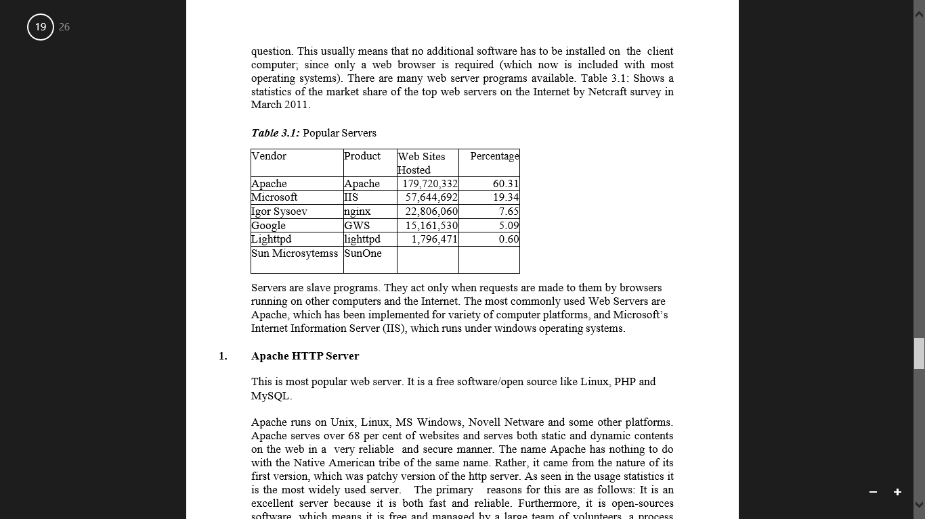
Popular servers

Slide 13
Servers contd
Servers are slave programs. They act only when requests are made to them by browsers running on other computers and the Internet. The most commonly used Web Servers are Apache, which has been implemented for variety of computer platforms, and Microsoft‘s Internet Information Server (IIS), which runs under windows operating systems.

Slide 14
In summary, you can distinguish between Web Client and Web Servers as follows:
Web Client
Connected to the Internet when needed
Usually runs Web browser(client)software such as Internet Explorer or Netscape
Uses HTTP
Request Web pages from a server
Receives Web Pages and files from as server
Web Server
• Continually connected to the Internet
• Runs Web server software (such as Apache or Internet Information Services (IIS)
• Uses HTTP
• Receives a request for the Web page
• Responds to the request and transmits the status code, Web page, and associated files

Slide 15

Q & A

